Slide 1
Linear Regression
Performed

Slide 2
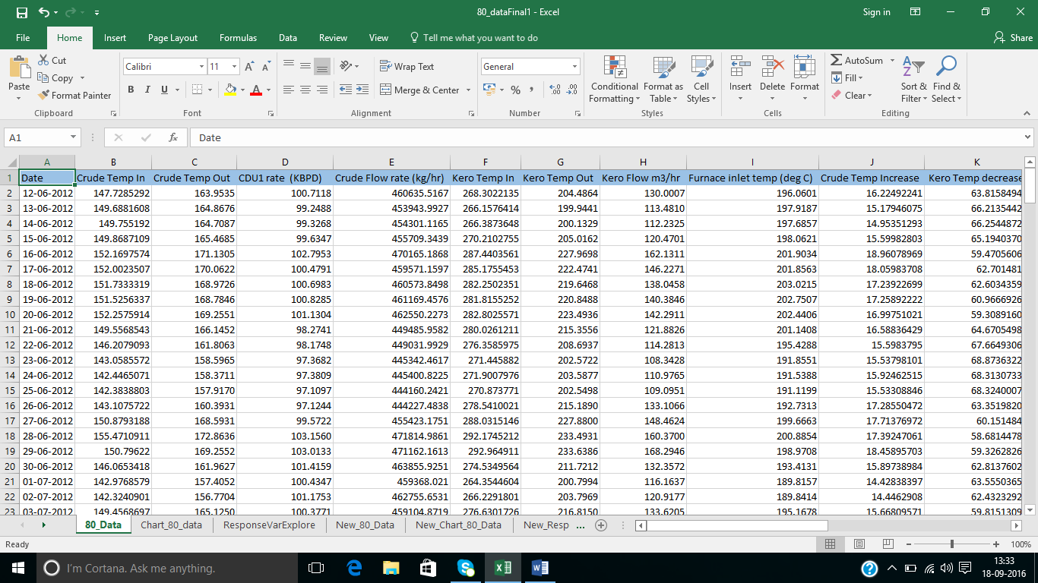
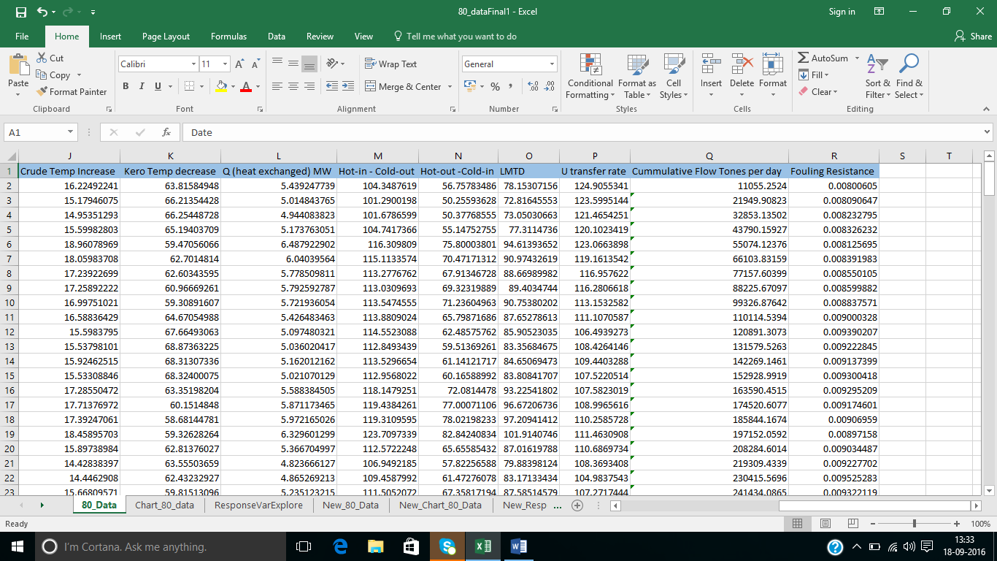
EXCHANGER DATA

Slide 3
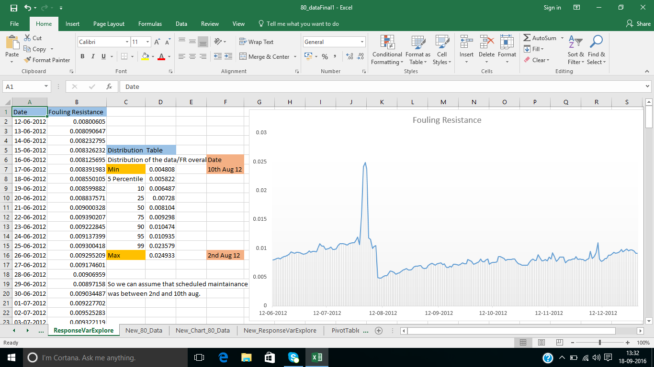
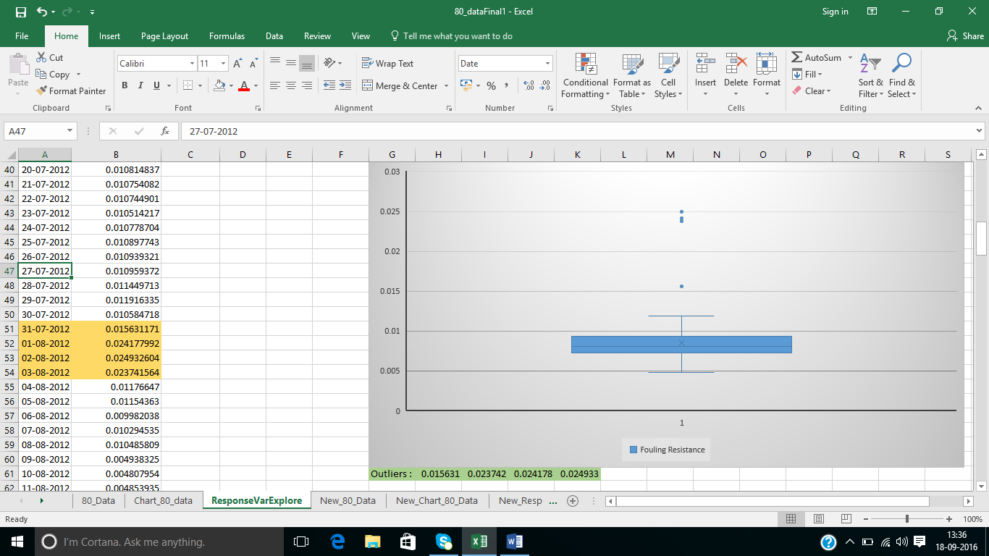
Response Variable Exploration
Notes:
Understanding Dependent variable i.e. its overall distribution, looking for outliers. Simple data distribution calculation such as max and min to know the day when FR was max and after that when it was min so we can know the time when exchanger needs maintenance.

Slide 4
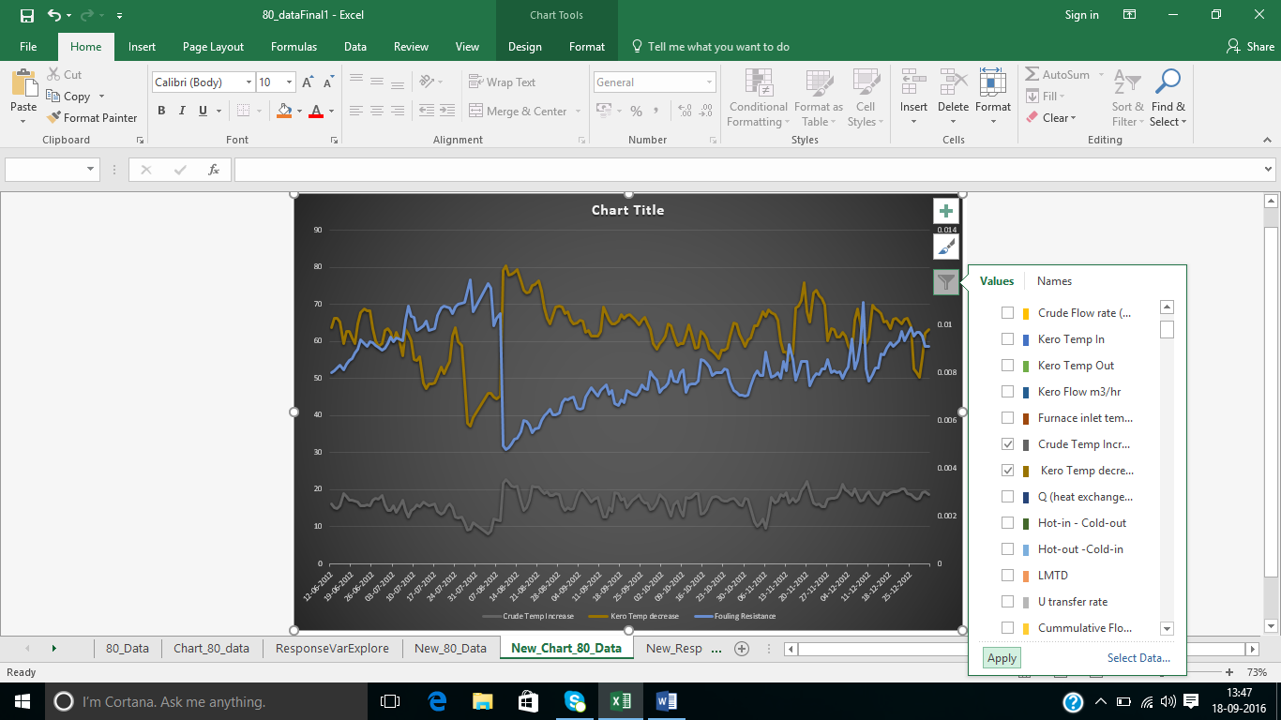
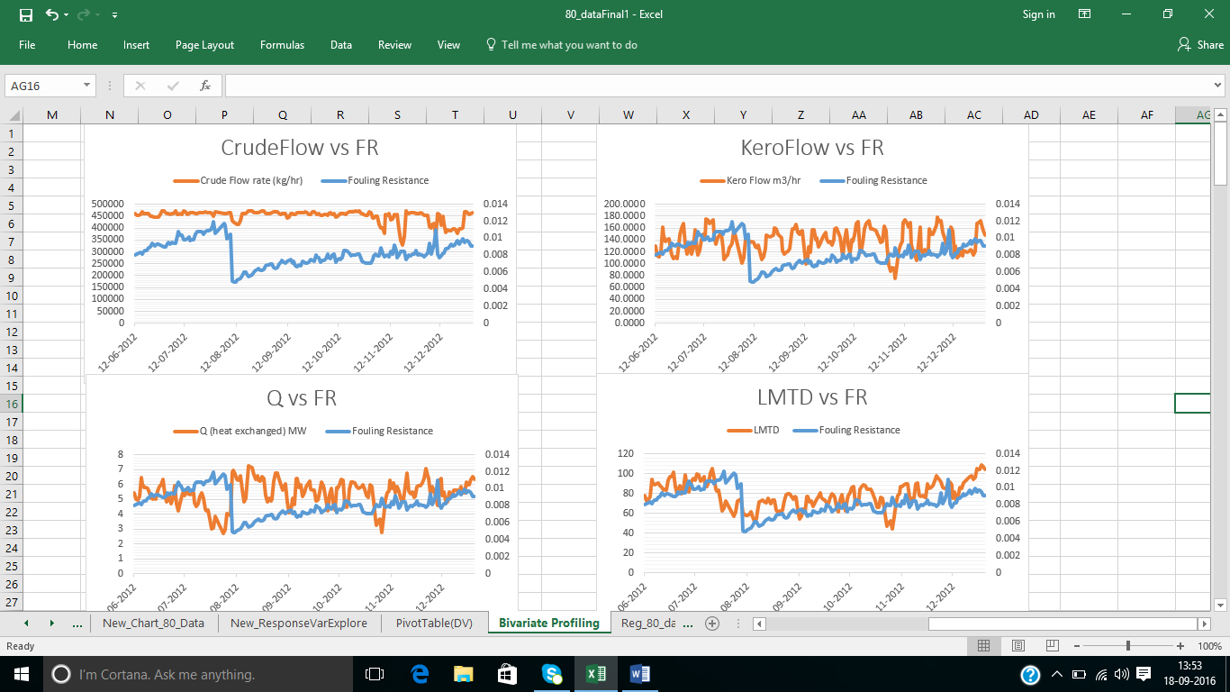
Bivariate Profiling
Notes:
In 1st chart we can compare 2 or more variables with FR i.e. all in one chart. In 2nd chart we study the impact of each of the variables on FR.

Slide 5
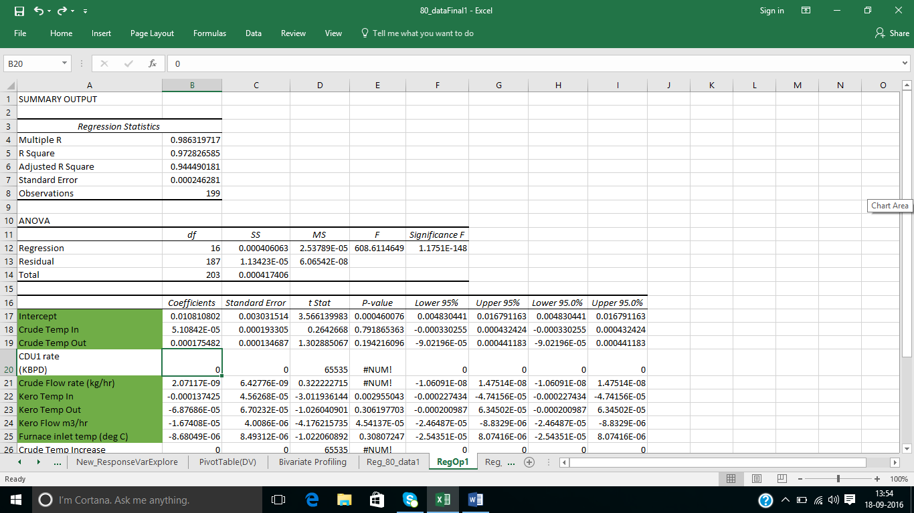
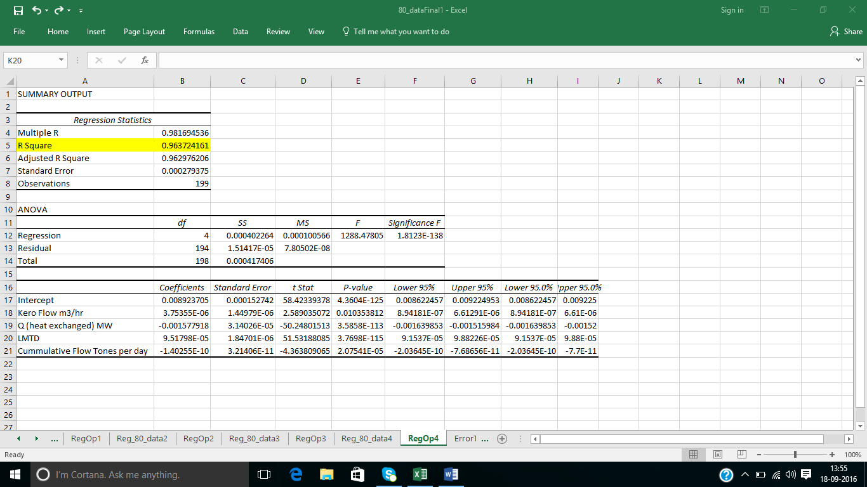
Linear Regression Performed
Notes:
In 1st image LR is performed with all the variables, after doing so we get summary output which have coefficients for the LR equation and R square value which tells us the predictable ability of the model. From 1st LR we got many insignificant variables so we remove those insignificant variables and redo LR till the time we get all significant variables and use those coefficients to get predicted value in real time scenario. Insignificance of a variable is decided by Individual Hypothesis testing, we do this testing so as to ensure that this LR model which we have applied on a sample data can also be able to predict appropriate values for population dataset.

Slide 6
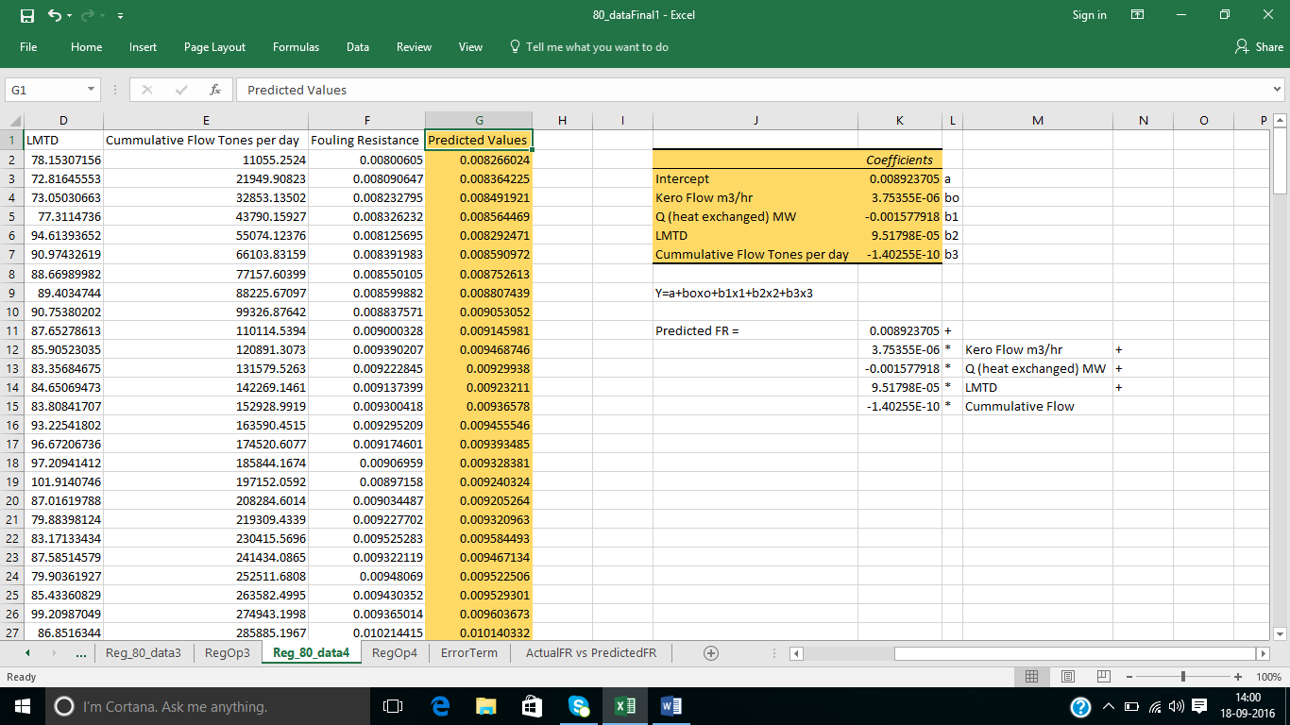
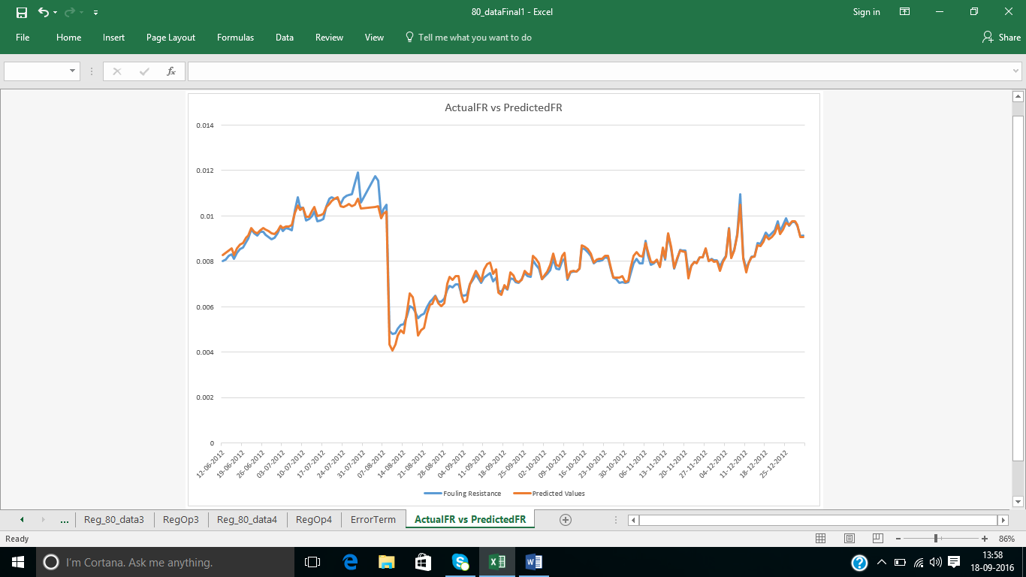
Notes:
Predicted FR = 0.008923705 + 3.75355E-06 * Kero Flow m3/hr -0.001577918 * Q (heat exchanged) MW+ 9.51798E-05 * LMTD -1.40255E-10 * Cumulative Flow.

